Slide 1
Supplementary Movie M1 to accompany Sigloch & Mihalynuk 2017 GSA Bulletin
Legend
Farallon Ocean trench
Mezcalera Ocean trench
Angayucham Ocean trench
Pacific Ocean trench
trench active in time slice shown (above growing slab)
trench not yet active (slab appears too early)
trench above ‘stagnant’ transition zone slab (nonlinear time-sinking relationship); trench inferred to coincide with migrating margin.

Slide 2
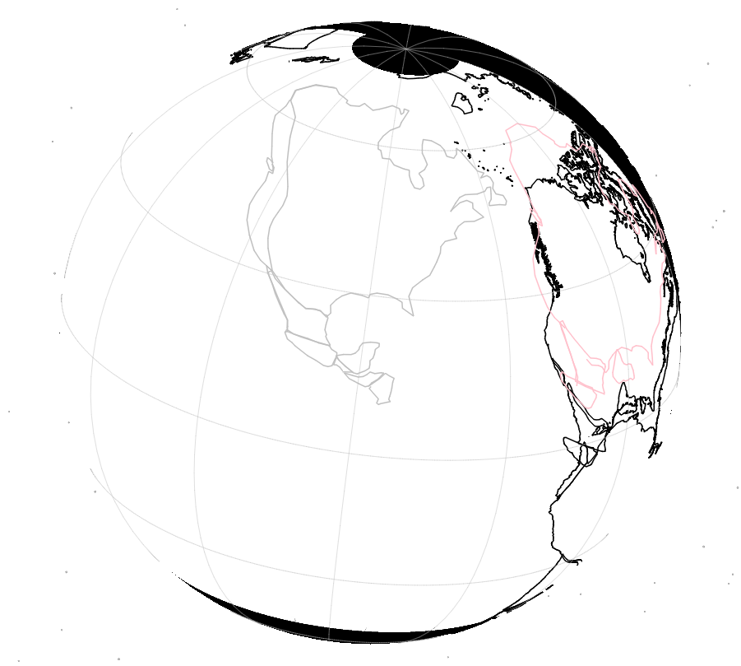
200 Ma
10.5 mm/a slab sinking rate.
Reconstruction by Seton et al. 2012, in hotspot/TPW reference frame. Tomography by Sigloch 2011, rendered at dVp/Vp = 0.25%

Slide 3
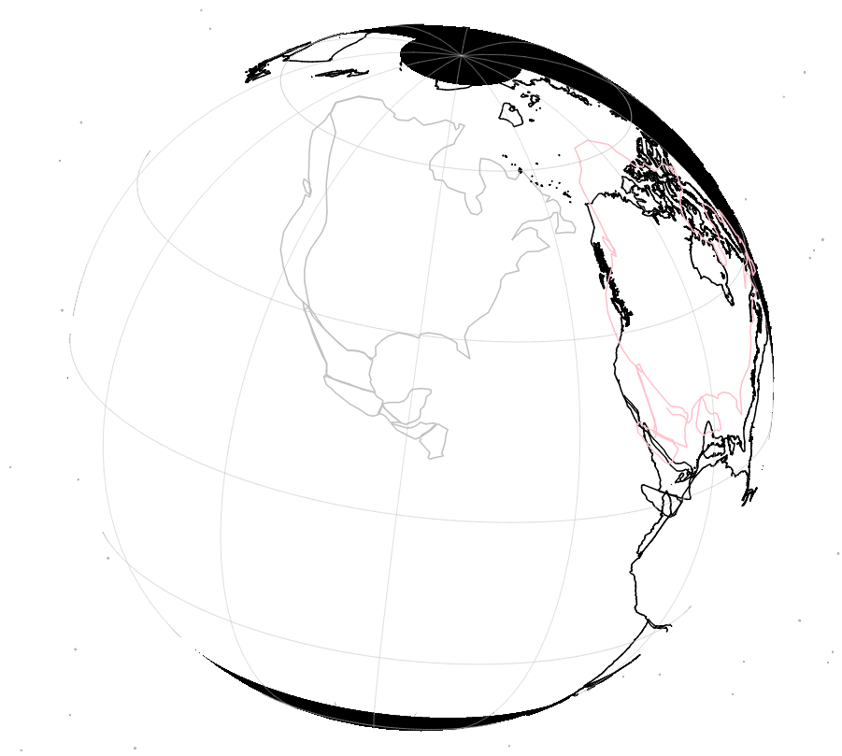
195 Ma

Slide 4
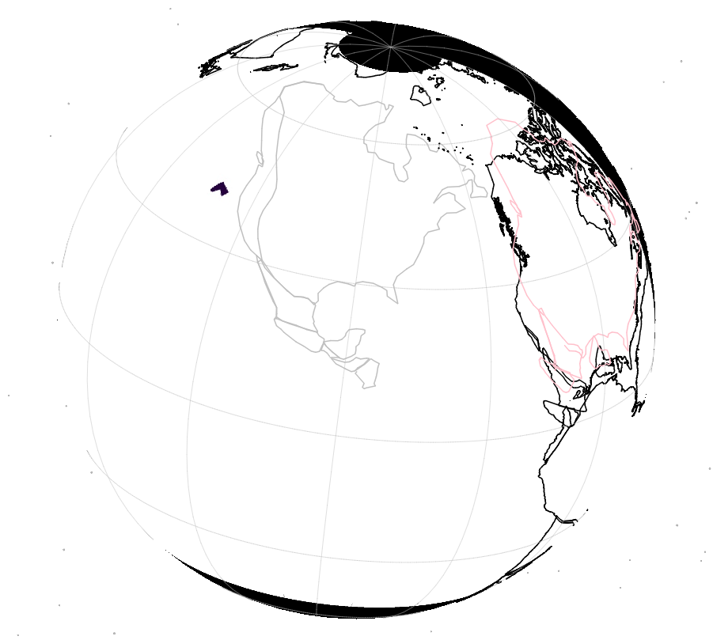
190 Ma

Slide 5
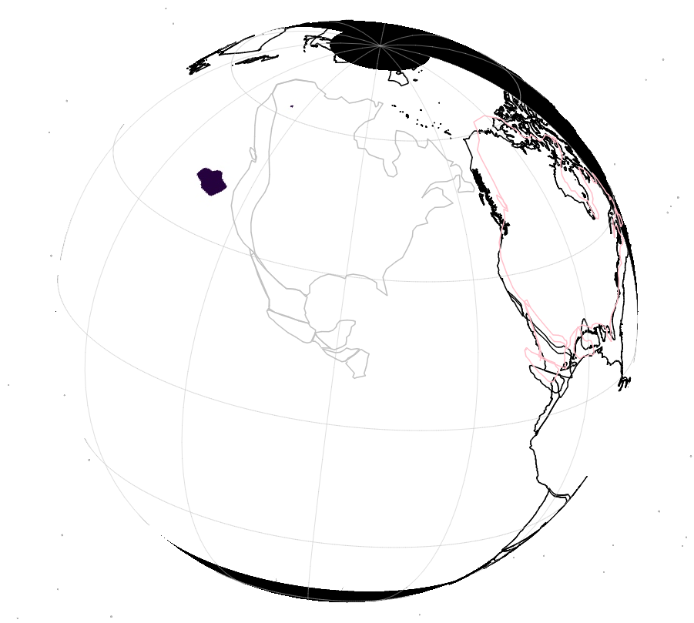
185 Ma

Slide 6
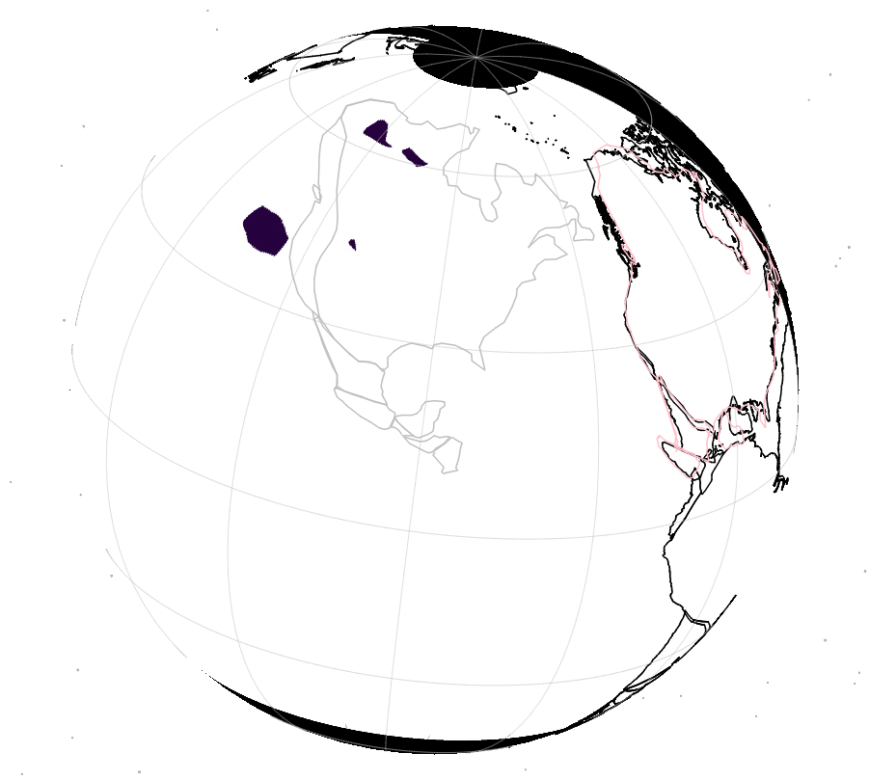
180 Ma

Slide 7
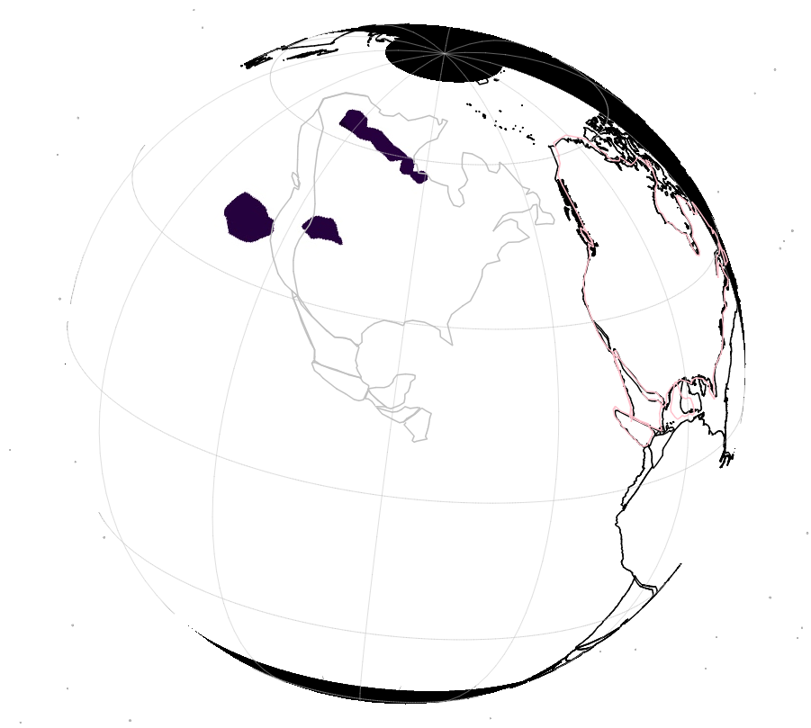
175 Ma
ANG
CR2
CR

Slide 8
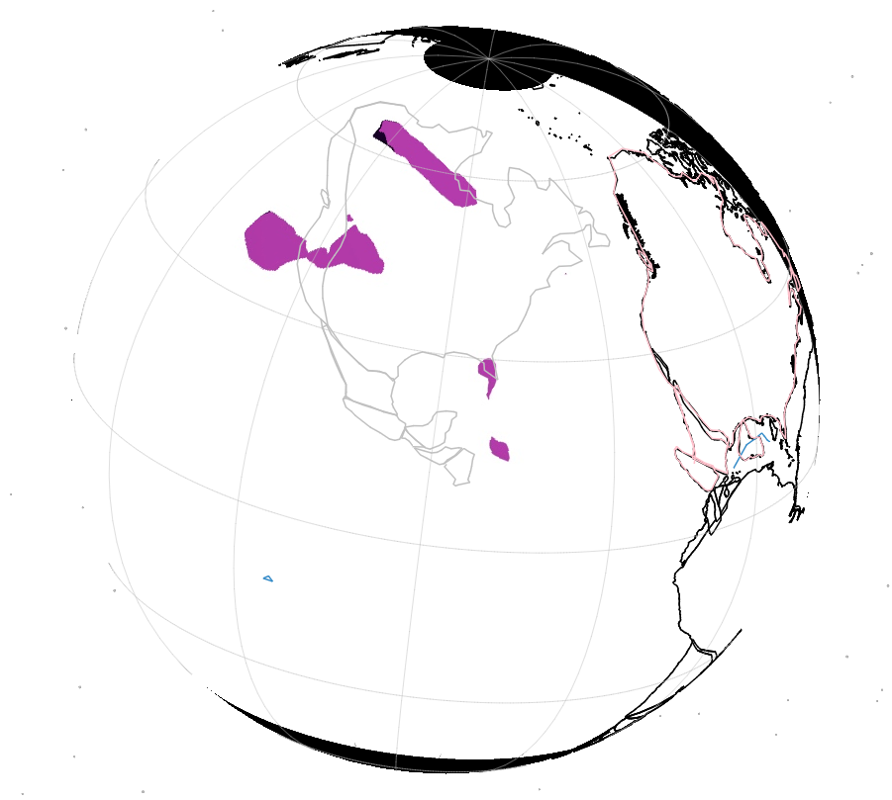
170 Ma
ANG
CR2
CR
MEZ

Slide 9
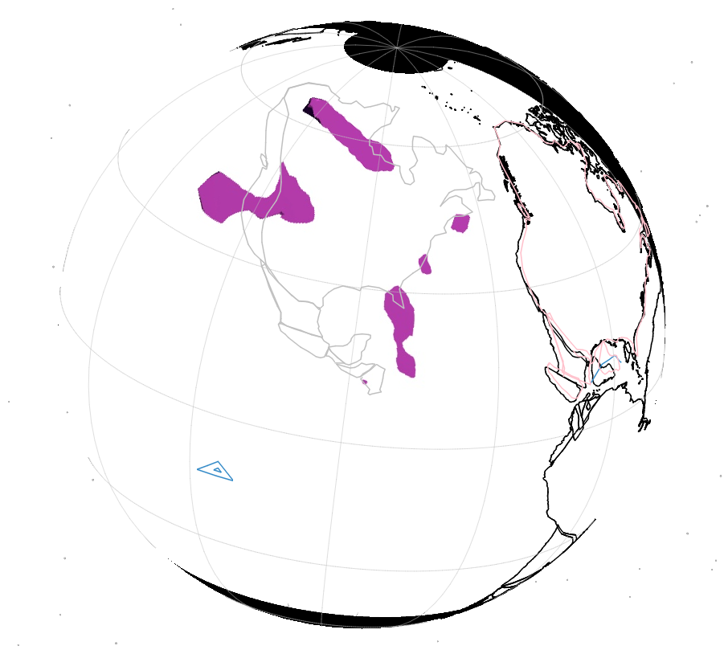
165 Ma
ANG
CR2
CR
MEZ
?
?

Slide 10
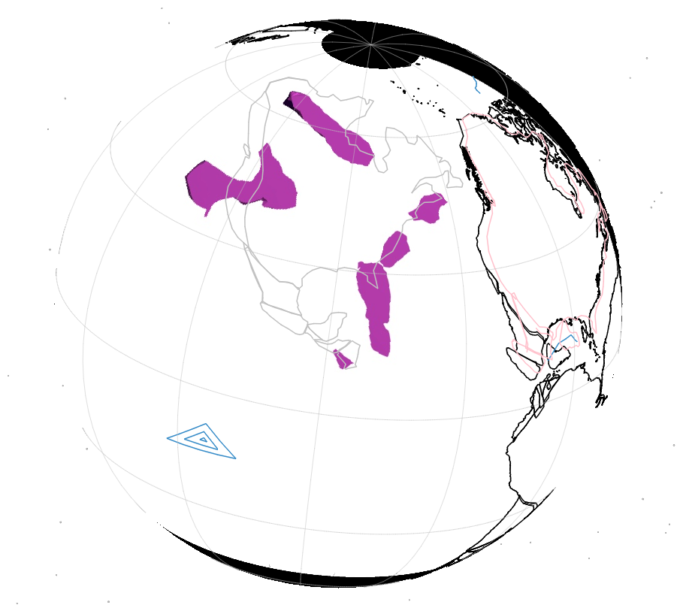
160 Ma
ANG
CR2
CR
MEZ
?
?

Slide 11
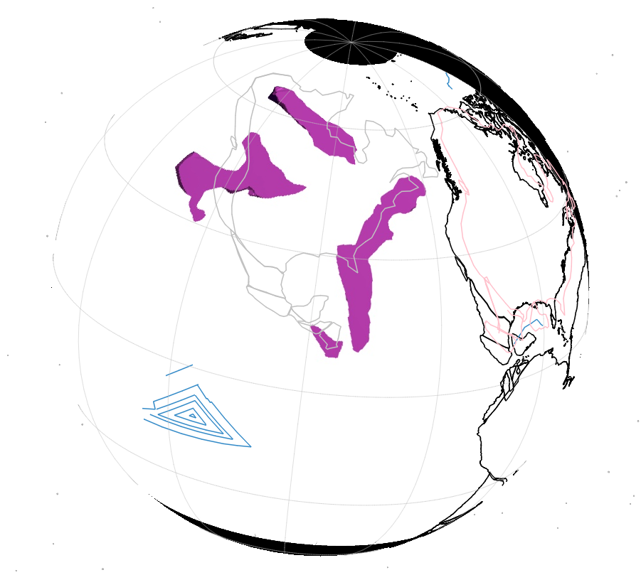
155 Ma
MEZ
SF1
?
?

Slide 12
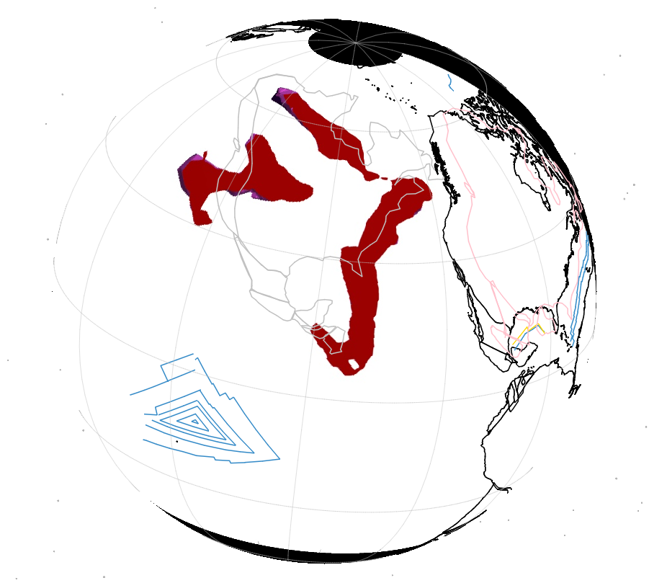
150 Ma
MEZ
SF1
?
?

Slide 13
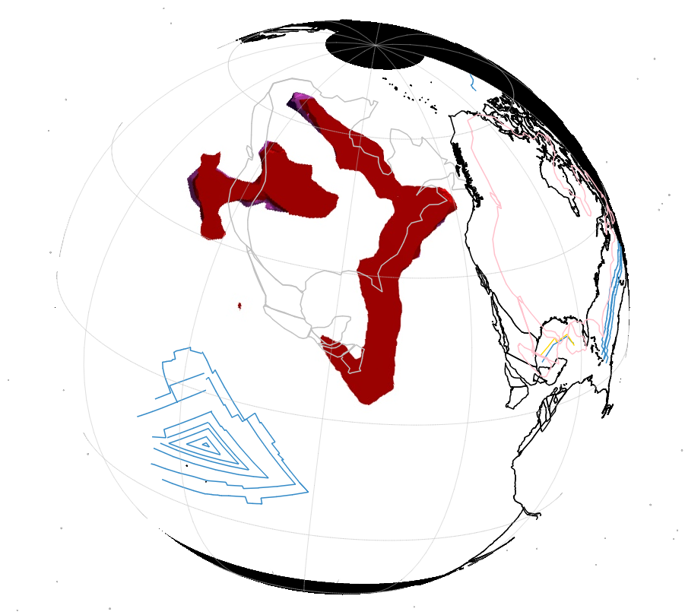
145 Ma
SF1
?
?

Slide 14
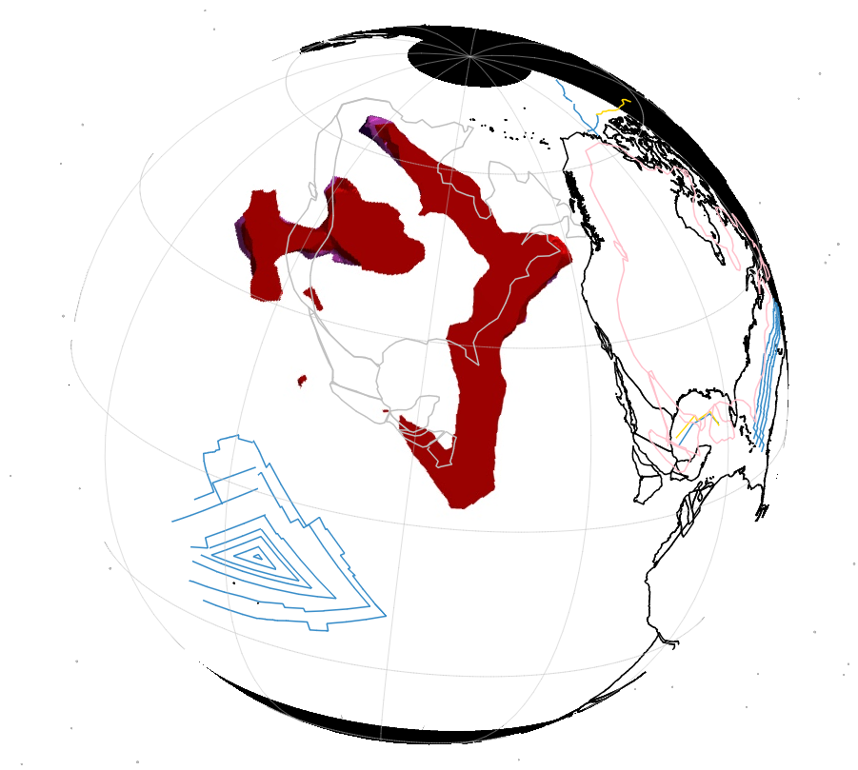
140 Ma
?
?
?
?

Slide 15
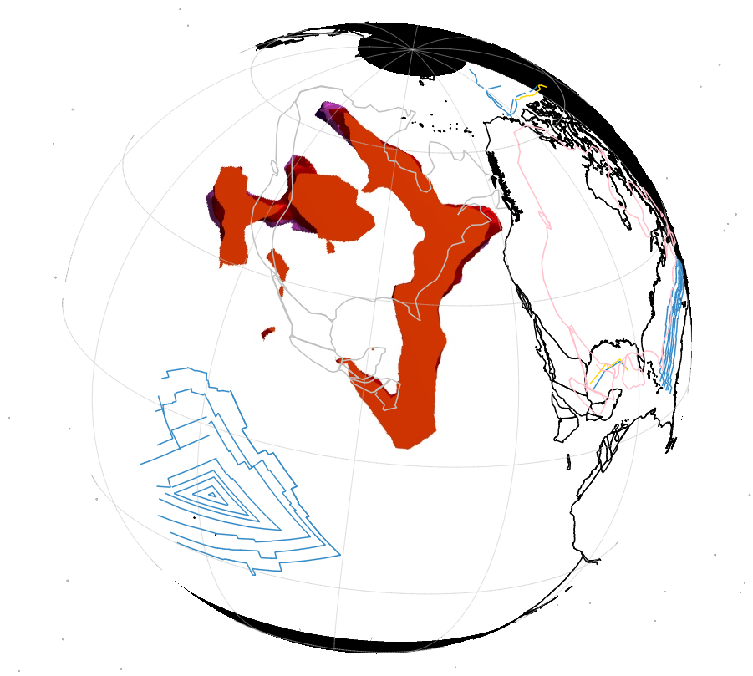
135 Ma
L1
?
?

Slide 16
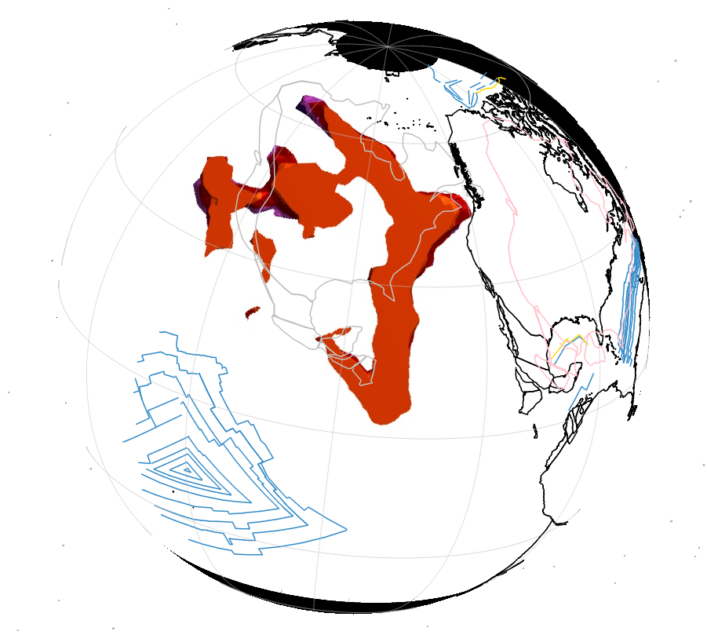
130 Ma
L1
?
?

Slide 17
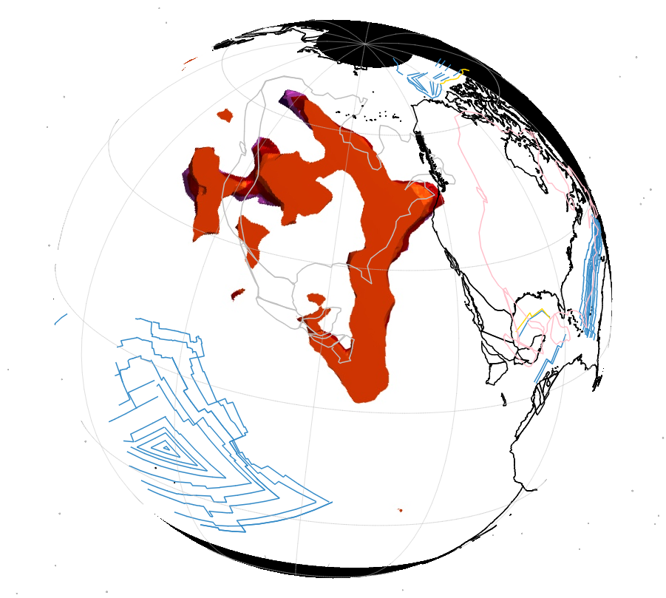
125 Ma
L1
?
?

Slide 18
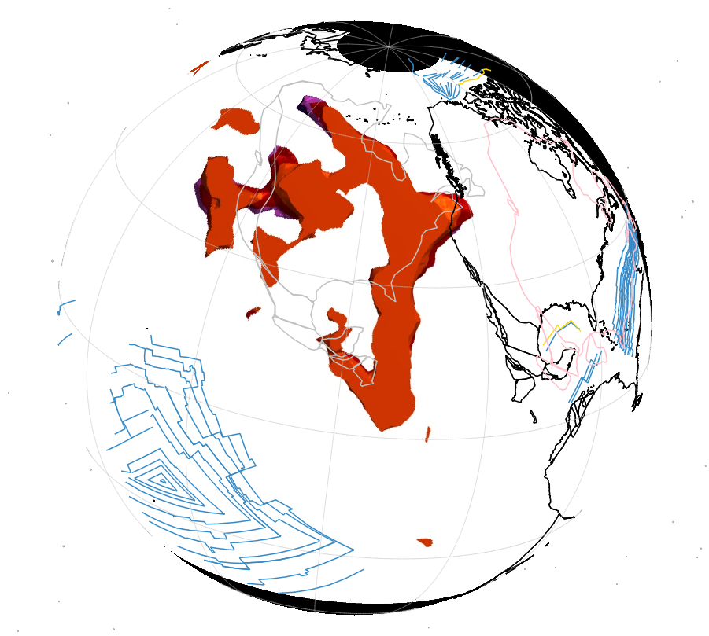
120 Ma
K
?
?

Slide 19
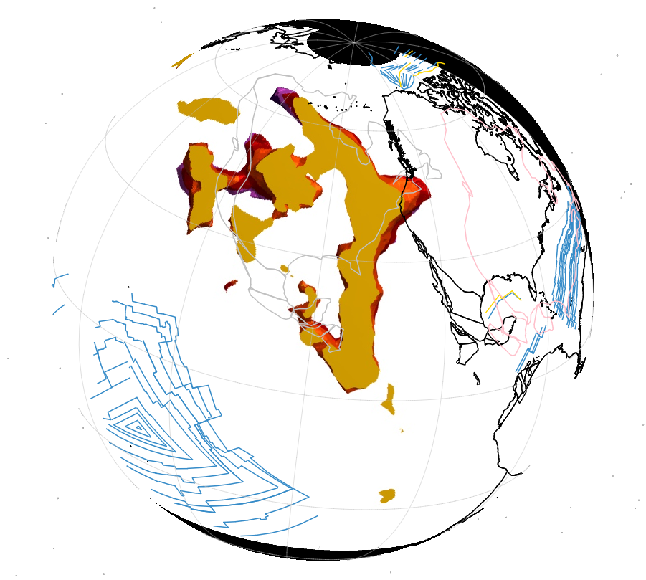
115 Ma
K
?
?

Slide 20
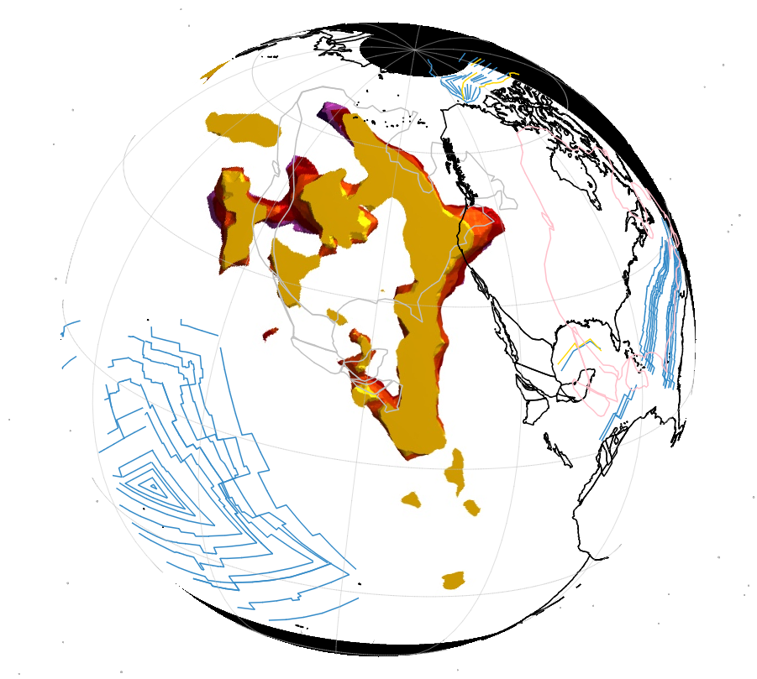
110 Ma
K
?
?

Slide 21
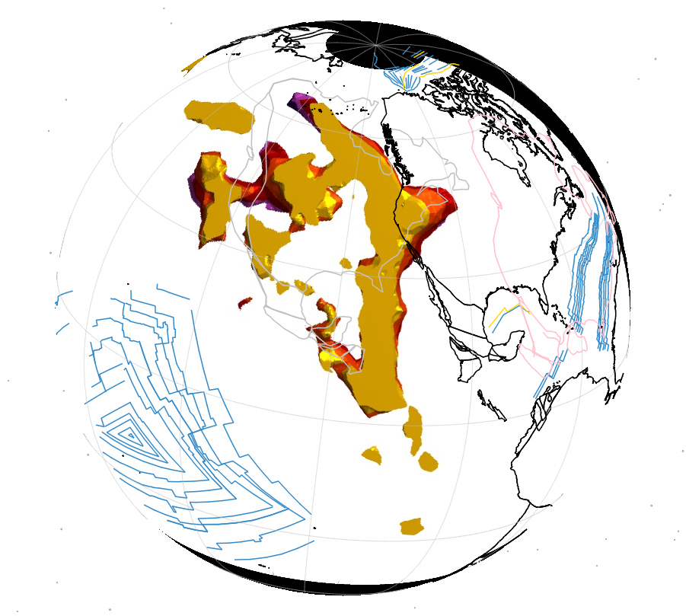
105 Ma
K
?
?

Slide 22
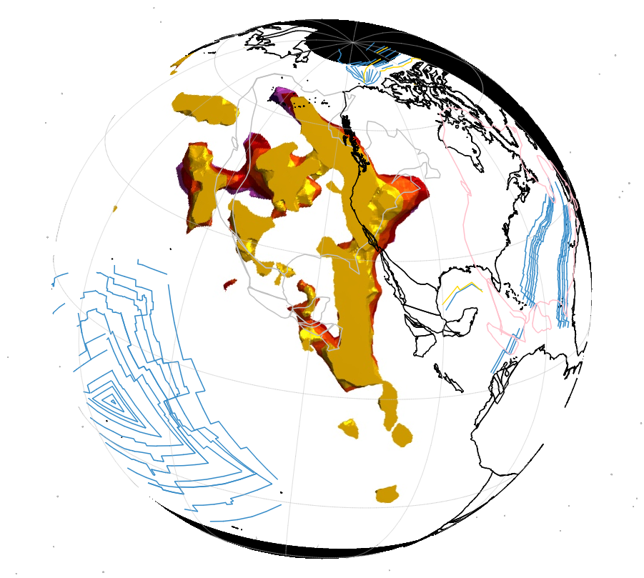
100 Ma
K
?
?

Slide 23
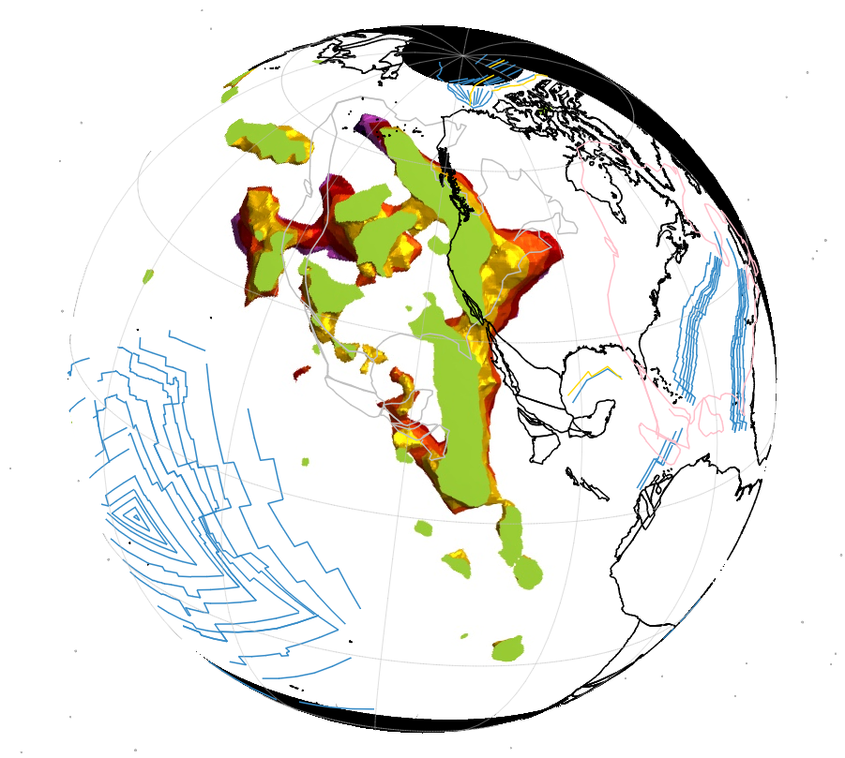
095 Ma
K
?
?

Slide 24
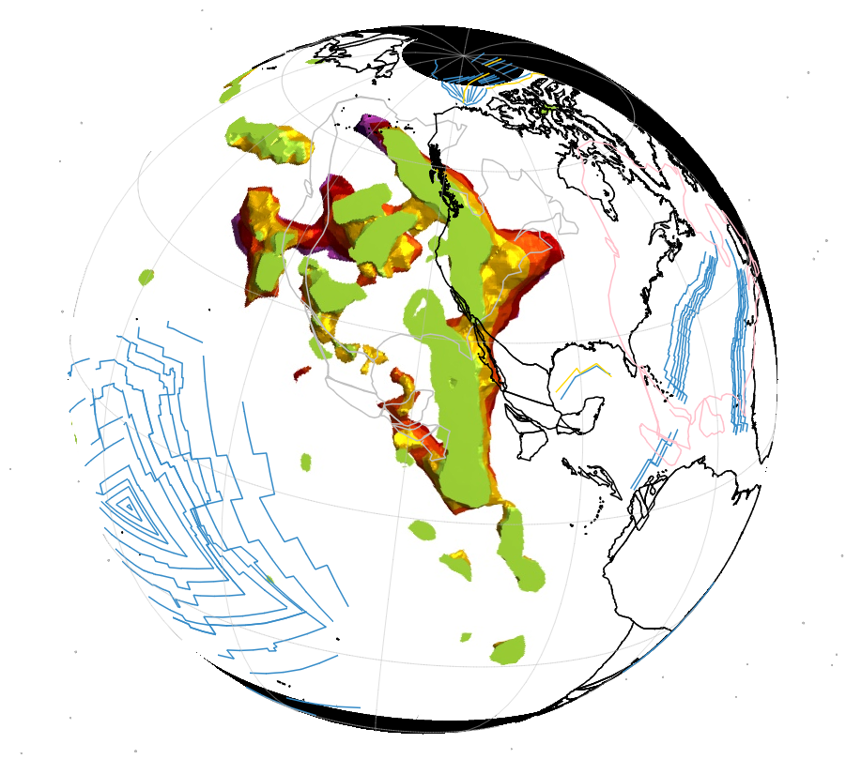
090 Ma
K
?
?

Slide 25
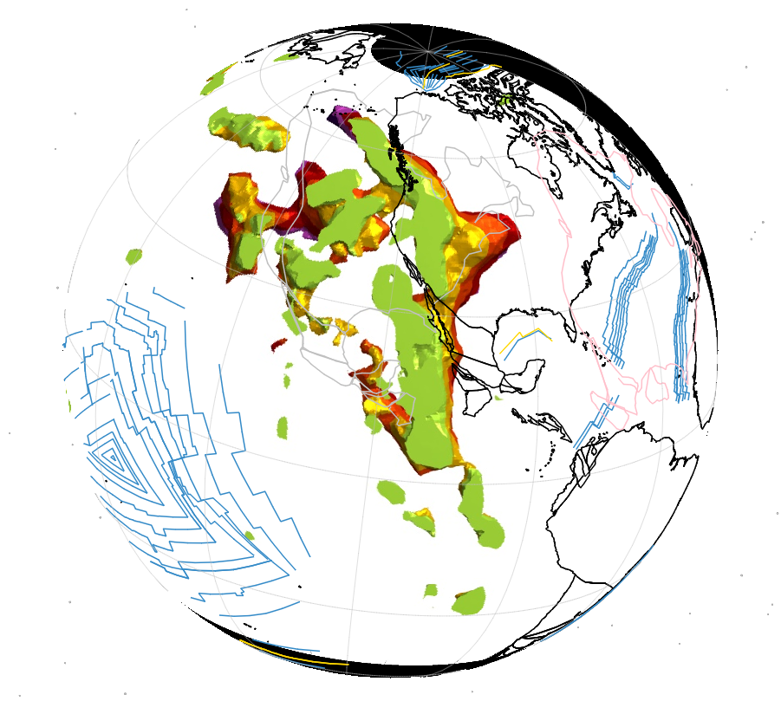
085 Ma
K
?
?

Slide 26
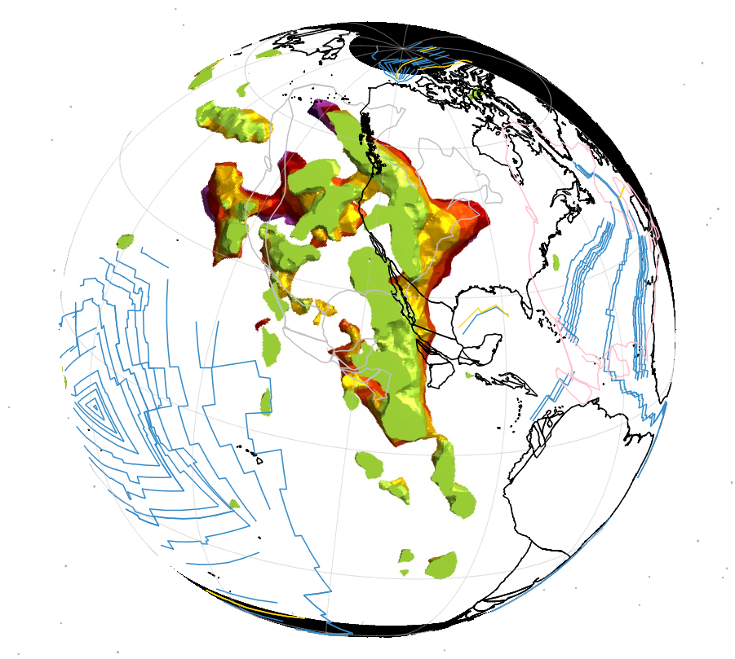
080 Ma
F/C
?
?

Slide 27
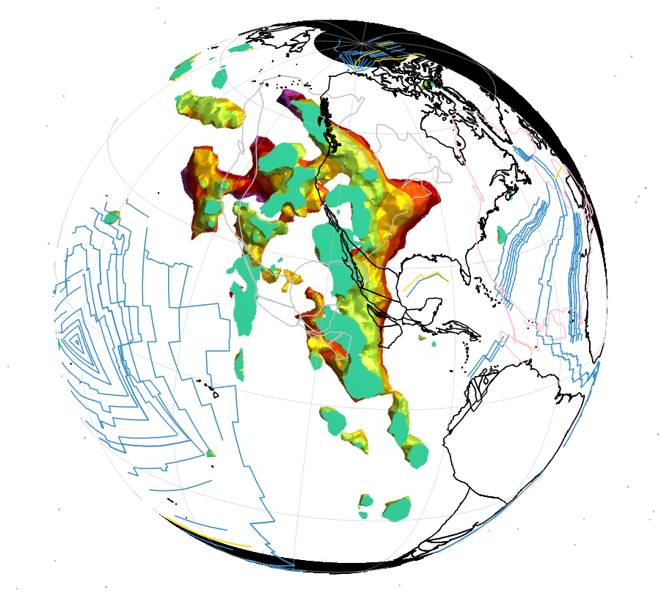
075 Ma
?
?

Slide 28
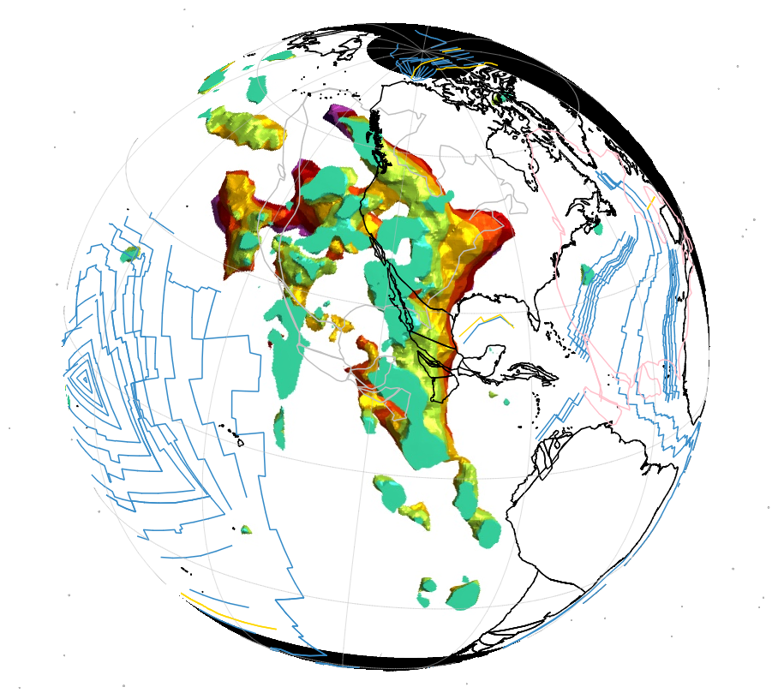
070 Ma
?
?

Slide 29
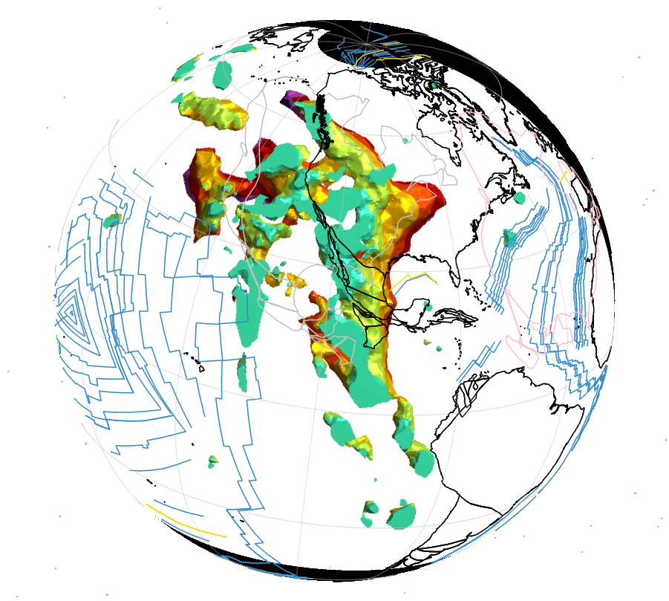
065 Ma
?
?

Slide 30
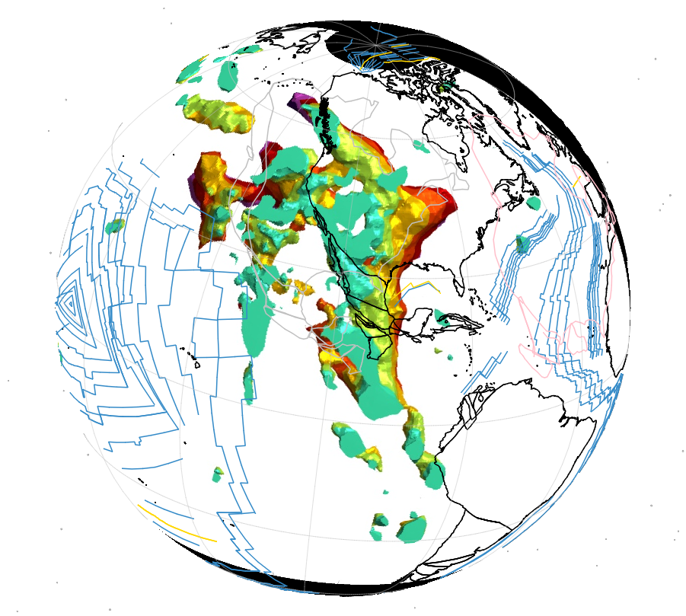
060 Ma
?
?

Slide 31
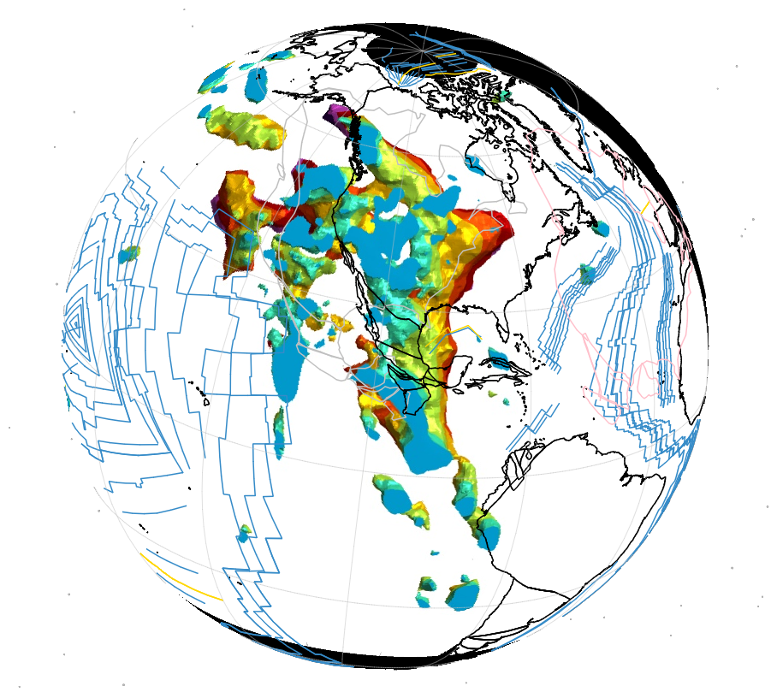
055 Ma
A
G

Slide 32
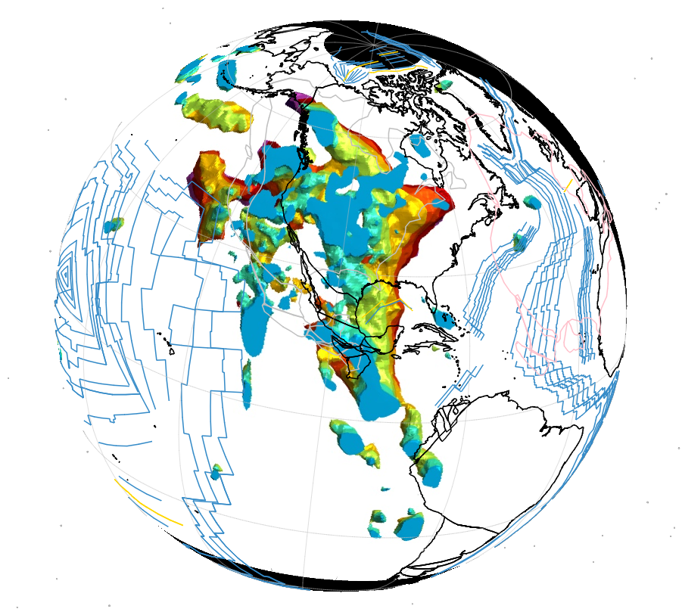
050 Ma

Slide 33
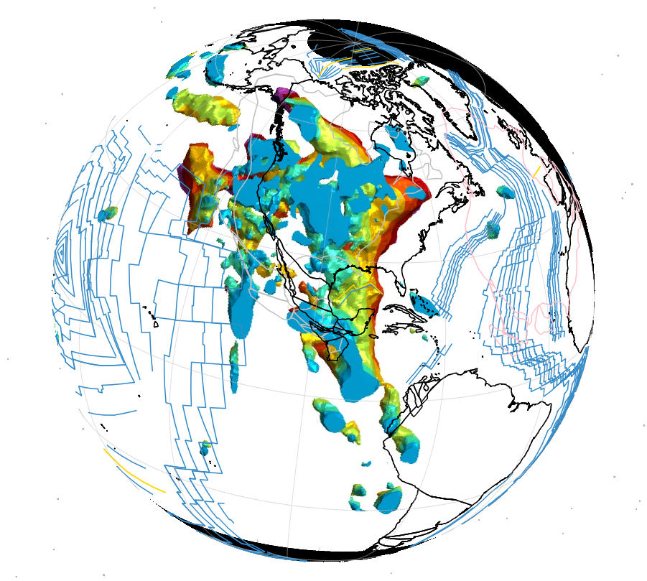
045 Ma
A

Slide 34
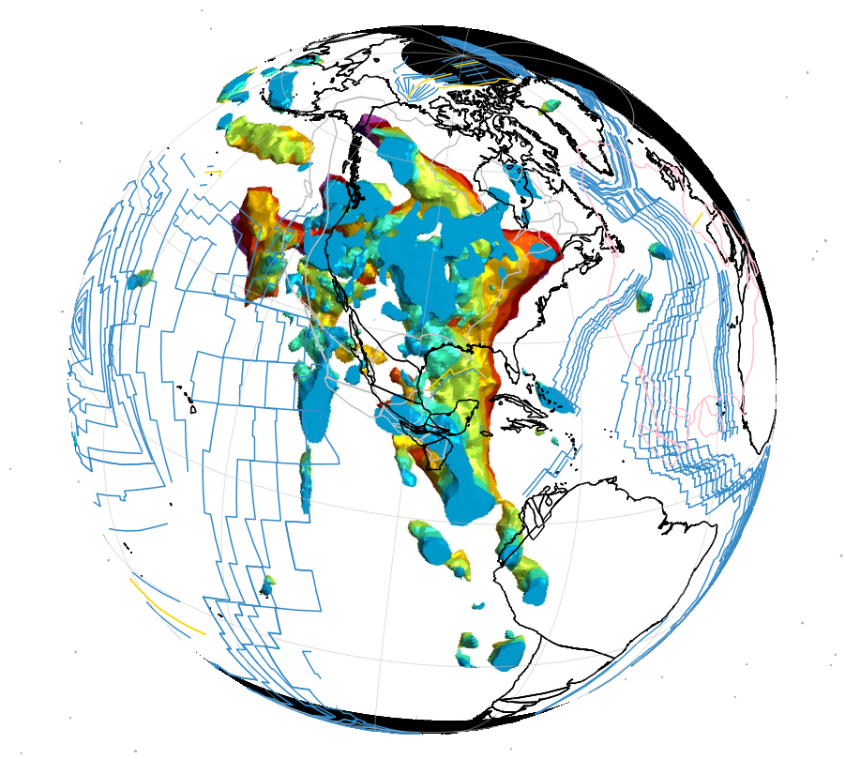
040 Ma
A

Slide 35
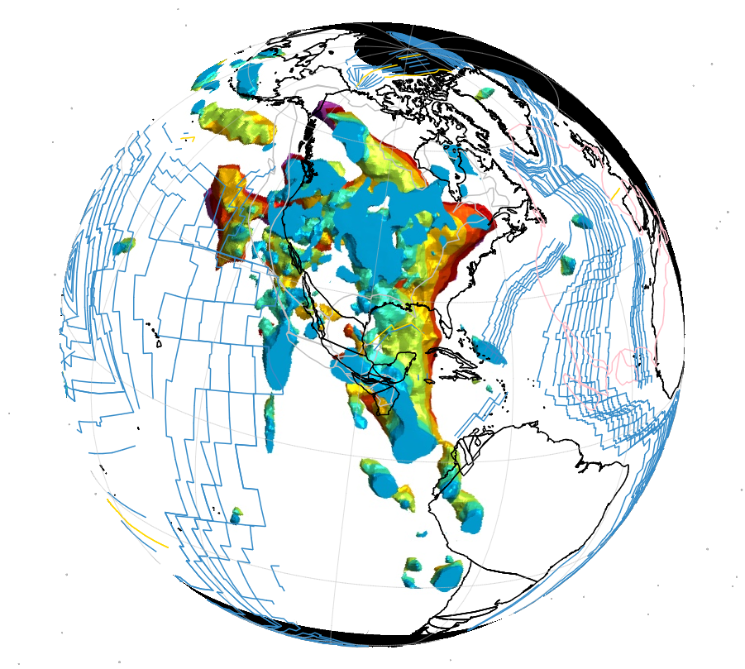
035 Ma
A

Slide 36
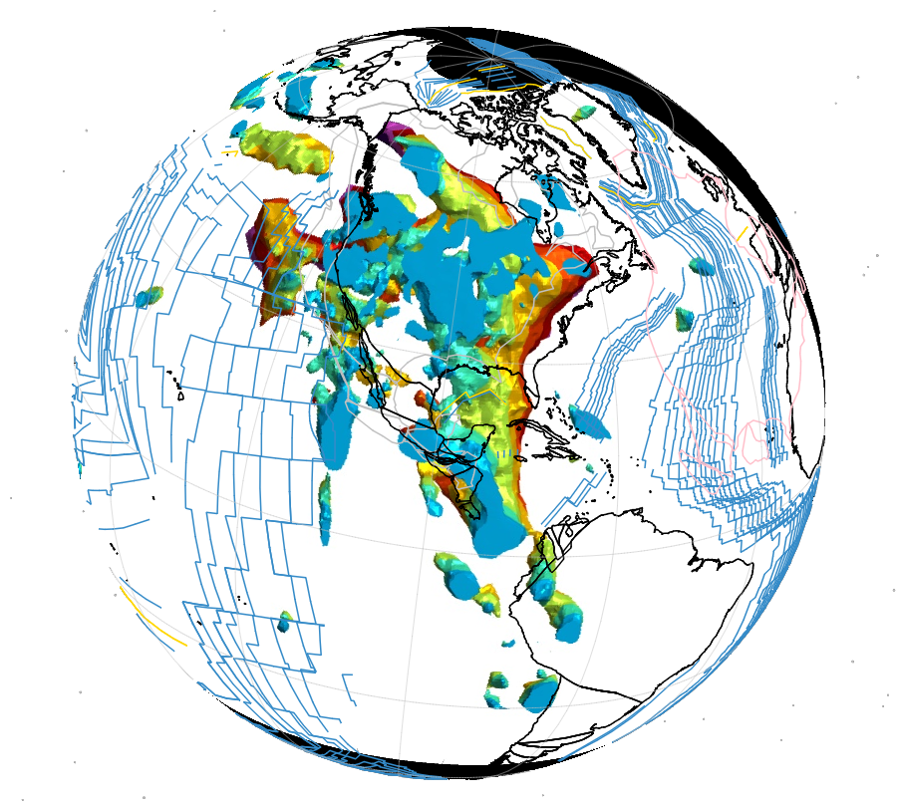
030 Ma
A

Slide 37
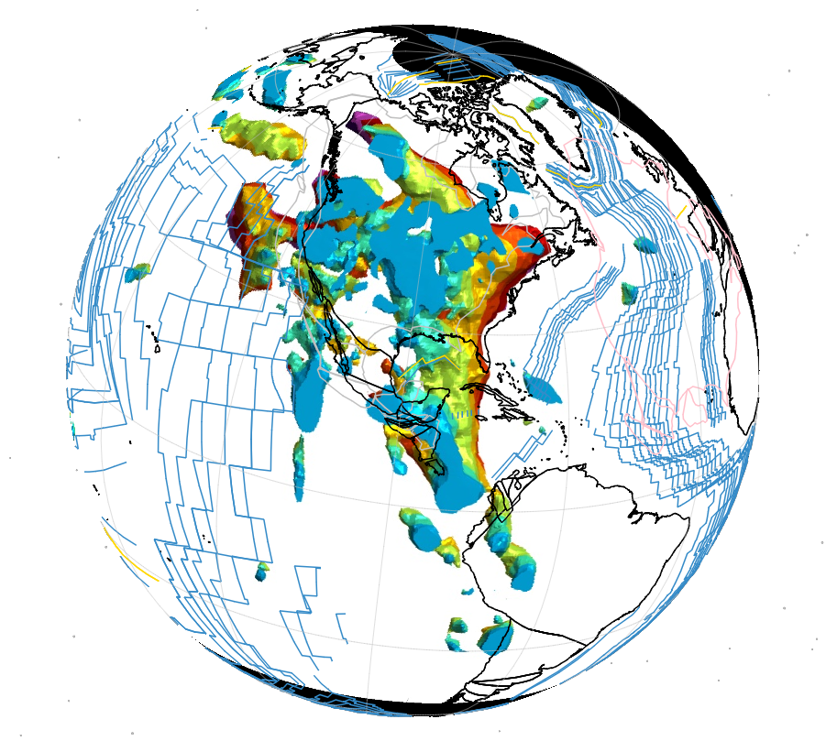
025 Ma

Slide 38
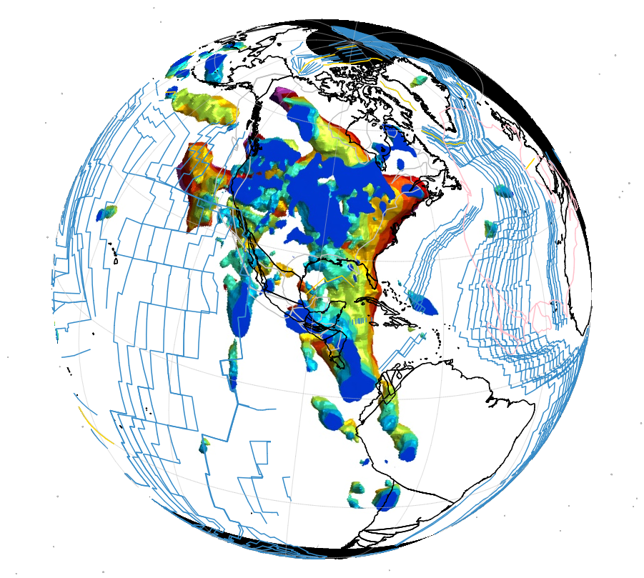
020 Ma

Slide 39
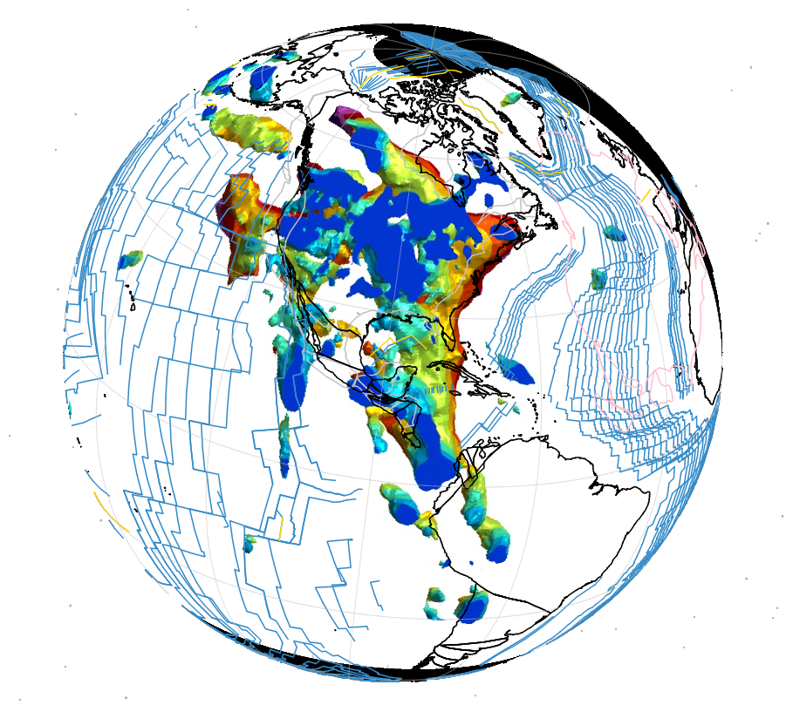
015 Ma

Slide 40
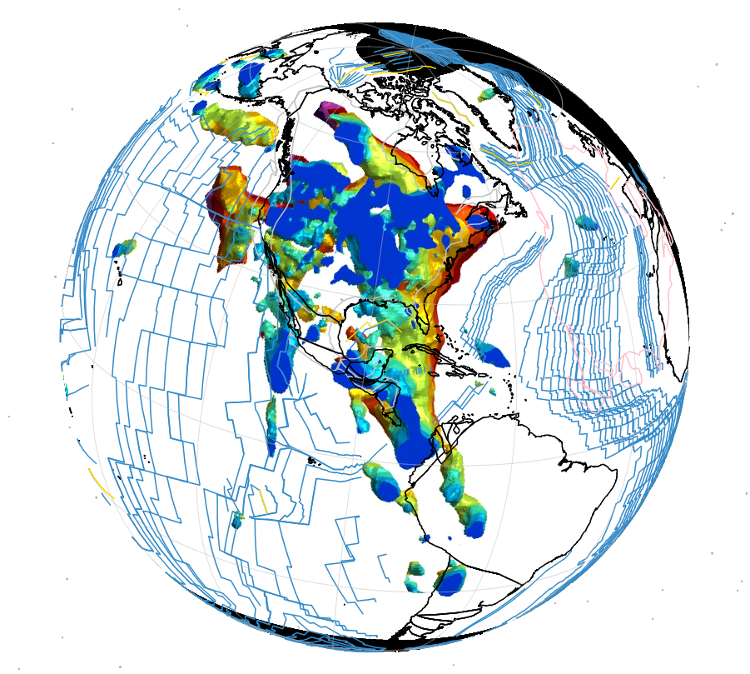
010 Ma

Slide 41
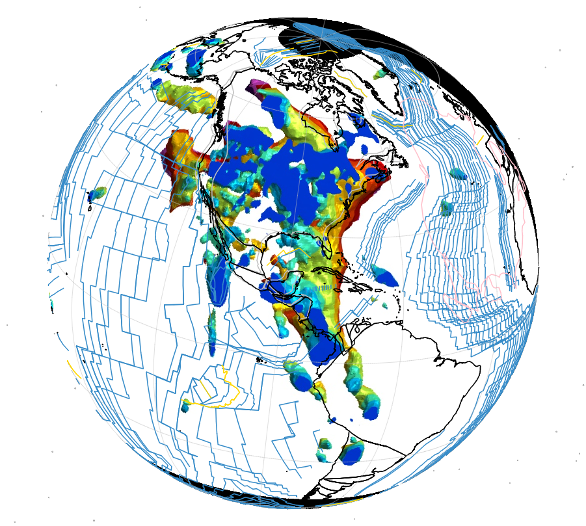
005 Ma

Slide 42
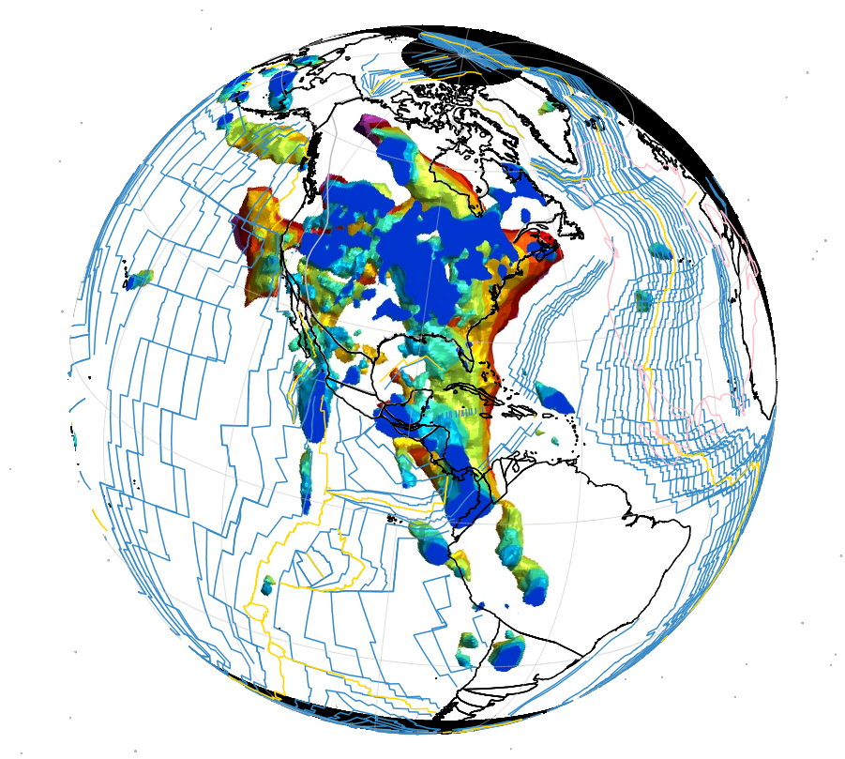
000 Ma
A
K
ANG
G
CR2
CR
L1
MEZ
SF1
F/C

